Slide 1
Project introduction
This presentation showcases the data analysis of DVD rentals using SQL, integrating data from 15 tables. It highlights key insights on customer behavior, film performance, and rental trends, demonstrating advanced SQL query techniques to uncover actionable patterns and insights.
Project Highlights
1. Comprehensive Data Integration: Merged data from 15 tables for a holistic view.
2. Advanced SQL Analysis: Employed sophisticated SQL queries to derive meaningful insights.
3. Rental Trends Analysis: Analyzed customer preferences, film categories, and staff contributions to rentals.

Slide 2
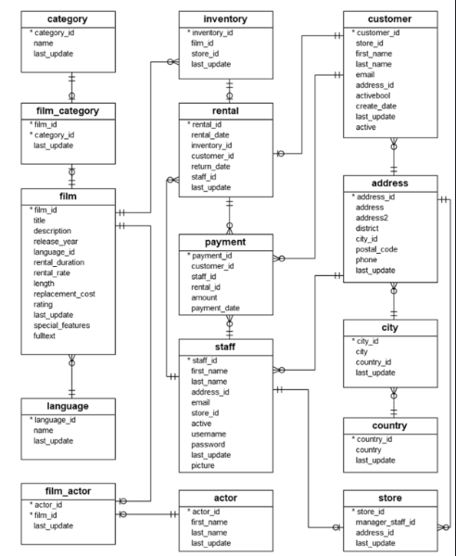
Schema

Slide 3
Q1: What is the total revenue generated by all rentals?
Code
SELECT
SUM(AMOUNT::NUMERIC) AS TOTAL_REVENUE
FROM
PAYMENT;
Answer set
"total_revenue"
67416.51

Slide 4
Q2: Which category of films generates the most revenue?
Code
SELECT
C.NAME AS CATEGORY,
SUM(P.AMOUNT::NUMERIC) AS TOTAL_REVENUE
FROM
PAYMENT P
JOIN RENTAL R ON P.RENTAL_ID = R.RENTAL_ID
JOIN INVENTORY I ON R.INVENTORY_ID = I.INVENTORY_ID
JOIN FILM_CATEGORY FC ON I.FILM_ID = FC.FILM_ID
JOIN CATEGORY C ON FC.CATEGORY_ID = C.CATEGORY_ID
GROUP BY
C.NAME
ORDER BY
TOTAL_REVENUE DESC
LIMIT
1;
Answer set
"category" "total_revenue"
"Sports" 5314.21

Slide 5
Q3: What is the average rental duration for all films?
Code
SELECT
AVG(RENTAL_DURATION::NUMERIC) AS AVERAGE_DURATION
FROM
FILM;
Answer set
"average_duration"
" 4.99"

Slide 6
Q4: Which city has the most customers?
Code
SELECT
CI.CITY,
COUNT(C.CUSTOMER_ID) AS TOTAL_CUSTOMERS
FROM
CUSTOMER C
JOIN ADDRESS A ON C.ADDRESS_ID = A.ADDRESS_ID
JOIN CITY CI ON A.CITY_ID = CI.CITY_ID
GROUP BY
CI.CITY
ORDER BY
TOTAL_CUSTOMERS DESC
LIMIT
1;
Answer set
"city" "total_customers"
"London" 2

Slide 7
Q5: What is the total number of rentals for each film?
Code
SELECT
F.TITLE,
COUNT(R.RENTAL_ID) AS TOTAL_RENTALS
FROM
RENTAL R
JOIN INVENTORY I ON R.INVENTORY_ID = I.INVENTORY_ID
JOIN FILM F ON I.FILM_ID = F.FILM_ID
GROUP BY
F.TITLE
ORDER BY
TOTAL_RENTALS DESC;
Answer set

Slide 8
"title" "total_rentals"
"BUCKET BROTHERHOOD" 34
"ROCKETEER MOTHER" 33
"FORWARD TEMPLE" 32
"JUGGLER HARDLY" 32
"GRIT CLOCKWORK" 32
"SCALAWAG DUCK" 32
"RIDGEMONT SUBMARINE" 32
"TIMBERLAND SKY" 31
"HOBBIT ALIEN" 31
"WIFE TURN" 31
"APACHE DIVINE" 31
"NETWORK PEAK" 31
"ROBBERS JOON" 31
"ZORRO ARK" 31
"RUSH GOODFELLAS" 31
"GOODFELLAS SALUTE" 31
"HARRY IDAHO" 30
"CAT CONEHEADS“ 30
"DOGMA FAMILY" 30
"RUGRATS SHAKESPEARE" 30

Slide 9
Q6: Which staff member processed the most payments?
Code
SELECT
S.FIRST_NAME || ' ' || S.LAST_NAME AS STAFF_NAME,
COUNT(P.PAYMENT_ID) AS TOTAL_PAYMENTS
FROM
PAYMENT P
JOIN STAFF S ON P.STAFF_ID = S.STAFF_ID
GROUP BY
S.FIRST_NAME,
S.LAST_NAME
ORDER BY
TOTAL_PAYMENTS DESC
LIMIT
1;
Answer set
"staff_name" "total_payments"
"Mike Hillyer" 8057

Slide 10
Q7: What is the distribution of customers across countries?
Code
SELECT
CO.COUNTRY,
COUNT(C.CUSTOMER_ID) AS TOTAL_CUSTOMERS
FROM
CUSTOMER C
JOIN ADDRESS A ON C.ADDRESS_ID = A.ADDRESS_ID
JOIN CITY CI ON A.CITY_ID = CI.CITY_ID
JOIN COUNTRY CO ON CI.COUNTRY_ID = CO.COUNTRY_ID
GROUP BY
CO.COUNTRY
ORDER BY
TOTAL_CUSTOMERS DESC;
Answer set

Slide 11
"country" "total_customers"
"India" 60
"China" 53
"United States" 36
"Japan" 31
"Mexico" 30
"Brazil" 28
"Russian Federation" 28
"Philippines" 20
"Turkey" 15
"Indonesia" 14
"Argentina" 13
"Nigeria" 13
"South Africa" 11
"Taiwan" 10
"United Kingdom" 9
"Poland" 8
"Iran" 8
"Germany" 7
"Italy" 7
"Venezuela" 7

Slide 12
Q8: What is the average payment amount for rentals?
Code
SELECT
TO_CHAR(AVG(AMOUNT::NUMERIC), '999.00') AS AVERAGE_PAYMENT
FROM
PAYMENT;
Answer set
"average_payment"
" 4.20"

Slide 13
Q9: Which film has the longest rental duration?
Code
SELECT
TITLE,
RENTAL_DURATION
FROM
FILM
ORDER BY
RENTAL_DURATION DESC
LIMIT
1;
Answer set
"title" "rental_duration"
"ADAPTATION HOLES" "7“

Slide 14
Q10: What is the total revenue generated by each store?
Code
SELECT
S.STORE_ID,
SUM(P.AMOUNT::NUMERIC) AS TOTAL_REVENUE
FROM
PAYMENT P
JOIN RENTAL R ON P.RENTAL_ID = R.RENTAL_ID
JOIN INVENTORY I ON R.INVENTORY_ID = I.INVENTORY_ID
JOIN STORE S ON I.STORE_ID = S.STORE_ID
GROUP BY
S.STORE_ID;
Answer set
"store_id" vvv"total_revenue"
"2" 33726.77
"1" 33689.74

Slide 15
Q11: Which film has the highest replacement cost?
Code
SELECT
TITLE,
REPLACEMENT_COST
FROM
FILM
ORDER BY
REPLACEMENT_COST DESC
LIMIT
1;
Answer set
"title" "replacement_cost"
"ANACONDA CONFESSIONS" "9.99"

